Slide 1
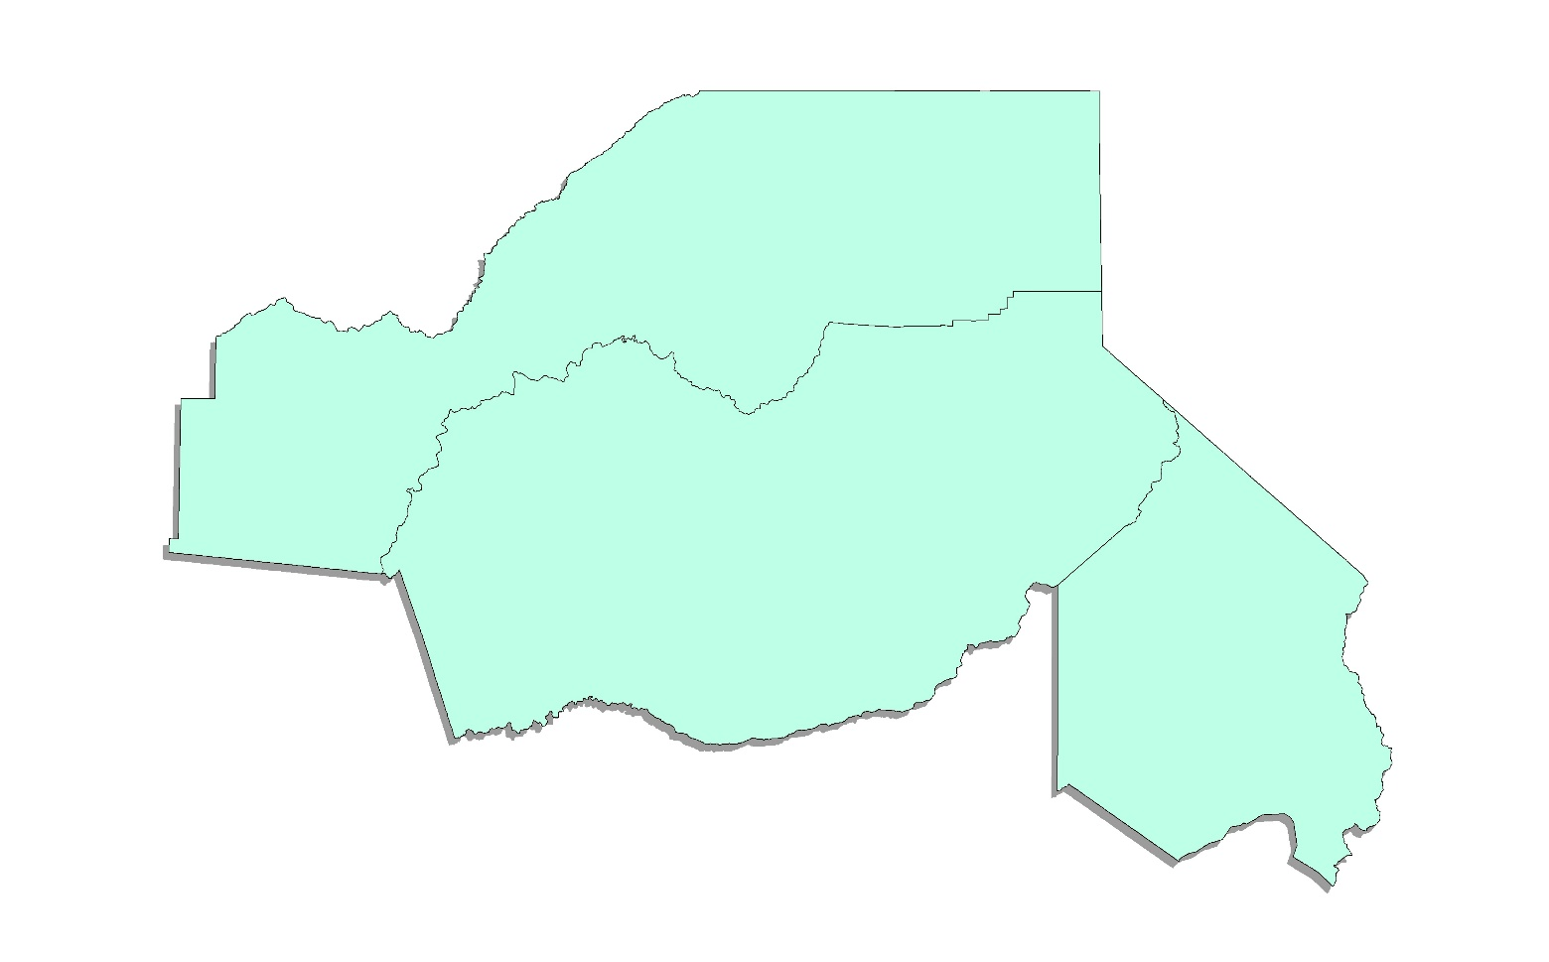
Golden Sierra LMI Update
Cara Welch, Researcher
EDD, Labor Market Information Division
July 18, 2024

Slide 2
Components of Labor Market Information
Civilian Labor Force (Federal-State Program)- counts based on residence, includes self-employed
Industry Employment (Federal-State Program)- counts based on work location, does not include self-employed

Slide 3
Civilian Labor Force
Source: CA Employment Development Department, Labor Market Information Division, Local Area Unemployment Statistics Program, May 2023/ May 2024

Slide 4
Golden Sierra Unemployment Rate Trend
Source: CA Employment Development Department, Labor Market Information Division, Local Area Unemployment Statistics

Slide 5
Job Growth in the Sacramento MSA
The pace of year-over job growth in the Sacramento MSA has slowed over the course of the expansion, returning to pre-pandemic levels.
Source: CA Employment Development Department, Labor Market Information Division, Current Employment Statistics

Slide 6
The Sacramento MSA Industry Employment
Source: CA Employment Development Department, Labor Market Information Division, Current Employment Statistics

Slide 7
The Sacramento MSA Industry Employment Recovery
Source: CA Employment Development Department, Labor Market Information Division, Current Employment Statistics

Slide 8
The Sacramento MSA Year-Over Industry Employment
Source: CA Employment Development Department, Labor Market Information Division, Current Employment Statistics

Slide 9
The Sacramento MSA Industry Employment Trends
Private education and health services led the region in year-over job gains in May 2024.
Source: CA Employment Development Department, Labor Market Information Division, Current Employment Statistics

Slide 10
The Sacramento MSA Industry Employment Trends
Government added 7,500 jobs since last May with gains nearly split between local and state government.
Source: CA Employment Development Department, Labor Market Information Division, Current Employment Statistics

Slide 11
The Sacramento MSA Industry Employment Trends
Trade, transportation, and utilities declined from May 2023 to May 2024 with a majority of the drop in transportation, warehousing, and utilities.
Source: CA Employment Development Department, Labor Market Information Division, Current Employment Statistics

Slide 12
Golden Sierra Job Growth
Golden Sierra job growth from 2022-2023 was1.8 percent, similar to the job growth in 2019.
Source: CA Employment Development Department, Labor Market Information Division, Current Employment Statistics

Slide 13
Golden Sierra Industry Employment
Source: CA Employment Development Department, Labor Market Information Division, Current Employment Statistics

Slide 14
Golden Sierra Industry Employment Recovery
Source: CA Employment Development Department, Labor Market Information Division, Current Employment Statistics

Slide 15
Golden Sierra Year-Over Industry Employment
Source: CA Employment Development Department, Labor Market Information Division, Current Employment Statistics

Slide 16
Thank you!
Cara Welch, Labor Market Researcher
Cara.Welch@edd.ca.gov
916-530-1700

Slide 17
The EDD is an equal opportunity employer/program. Auxiliary aids and services are available upon request to individuals with disabilities.

