Slide 1
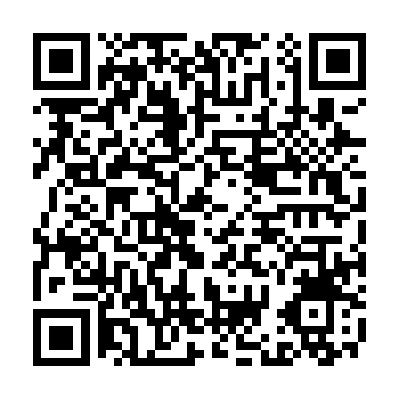
Join Our Team
Sacramento Virtual Hiring Event!
Join us for virtual interviews on Thursday, April 2nd from 11:30 to 1:00 pm Pacific Time by joining the virtual session hosted by Golden Sierra our valued community partner, Golden Sierra Job Training Agency.
No appointment needed—just bring your resume and enthusiasm!
Gainwell Technologies is an Equal Opportunity Employer, where all qualified applicants will receive consideration for employment without regard to race, religion, color, national origin, gender (including pregnancy, childbirth, or related medical condition), age, sexual orientation, status as a protected veteran, status as an individual with a disability, or other applicable legally protected characteristics.

