Slide 1

Labor Market Update Golden Sierra Workforce Development Board
March 17, 2022
Cara Welch
Labor Market Consultant, LMID

Slide 2
January 2022
Civilian Labor Force & Unemployment Rate
Sources: US Bureau of Labor Statistics; EDD, LMID, Local Area Unemployment Statistics
 | Labor Force | Employed | Unemployed | Unemployment Rate
United States | 162,825,000 | 155,618,000 | 7,207,000 | 4.4%
California | 19,150,000 | 18,104,900 | 1,045,100 | 5.5%
Sacramento MSA | 1,108,700 | 1,053,400 | 55,200 | 5.0%
Golden Sierra | 282,700 | 271,600 | 11,100 | 3.9%
Golden Sierra Region includes: Alpine, El Dorado and Placer counties. Sacramento MSA includes El Dorado, Placer, Sacramento, and Yolo counties. Data is preliminary and not seasonally adjusted.

Slide 3
Golden Sierra New Weekly Unemployment Insurance Claims
January 2020 – March 2022
Source: EDD, Unemployment Insurance Branch
Golden Sierra Region includes: Alpine, El Dorado and Placer counties. The data provided is the number of Unemployment Insurance “new” claim counts.
A “new claim” is the first claim for a benefit year period (ie. for the regular UI program it is 52 weeks). An individual would only have one new claim during a benefit year period.

Slide 4
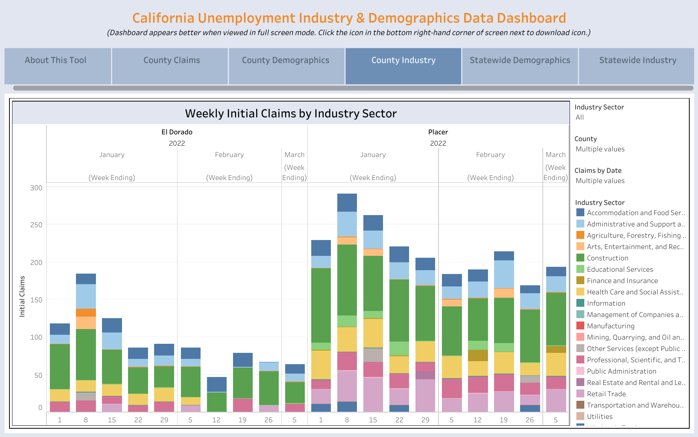
Source: EDD, Unemployment Insurance Branch. The data provided is the number of Unemployment Insurance “initial” claim counts, which includes new claims, additional claims, and transitional claims.

Slide 5
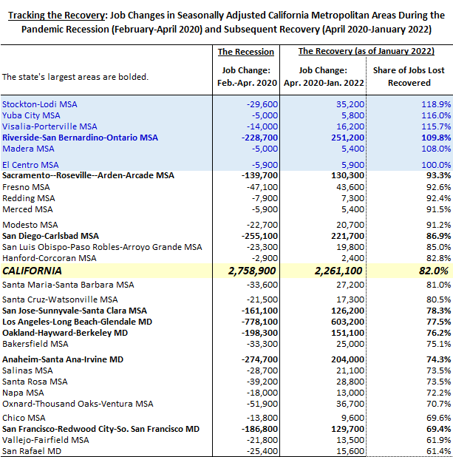
Tracking the Recovery in California Metropolitan Areas as of January 2022
Source: EDD, LMID, Current Economic Statistics, January 2022 data is preliminary and seasonally adjusted.

Slide 6
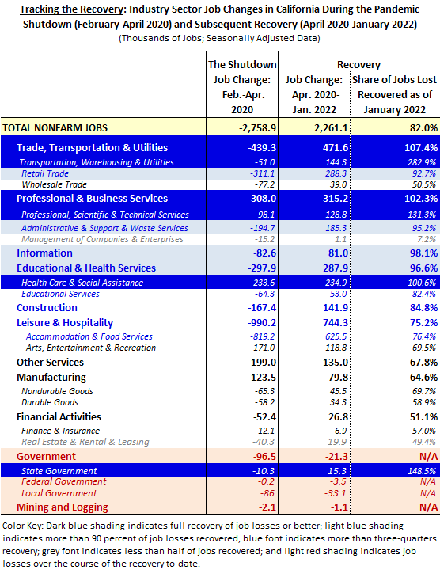
Tracking California’s Industry Recovery
Source: EDD, LMID, Current Economic Statistics, January 2022 data is preliminary and seasonally adjusted.

Slide 7
Sacramento MSA Employment Change
February 2020 – January 2022
Source: EDD, LMID, Current Economic Statistics
Sacramento MSA includes: El Dorado, Placer, Sacramento, and Yolo counties. January 2022 data is preliminary.

Slide 8
The EDD is an equal opportunity employer/program. Auxiliary aids and services are available upon request to individuals with disabilities.

